Slide 1


Slide 2
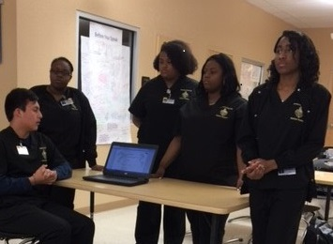
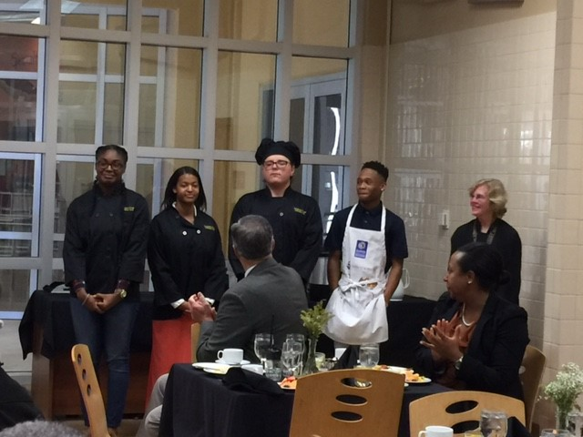
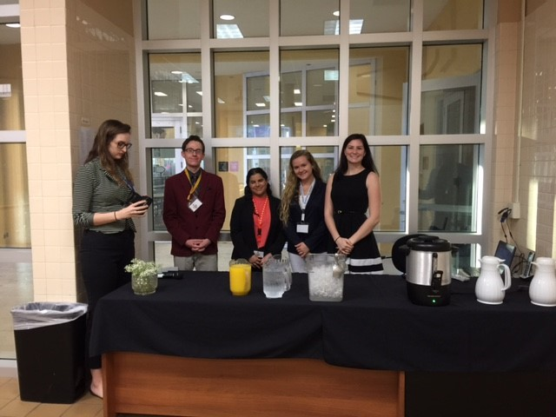
Teacher Grants 2022-2023
Funding Educational Initiatives
$146,000 will be awarded in Teacher Grants
  Increasing Graduation Rates
  Support for Low-Performing Students
  Literacy
  Career and Technical Education
  Teaching Quality
  STEM Education

Slide 3

Teacher Grants 2022-2023
Applications for Teacher Grant funds are available online.
Log on to: slpsgrants.awardspring.com and set up your account.
If you already have an account you may be required to reset your password by clicking forgot password.
TEACHER GRANT APPLICATION PROCESS

Slide 4

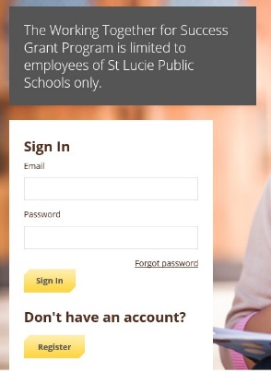
Teacher Grants 2022-2023
TEACHER GRANT SIGN- ON SCREEN
Notes:
When you log on to www.slpsgrants.awardspring.com, you will be taken the following SIGN-ON Screen.

Slide 5
Teacher Grants 2022-2023
1ST STEP
REGISTER
or SIGN IN
Notes:
First time users, need to register. Click on REGISTER button.

Slide 6
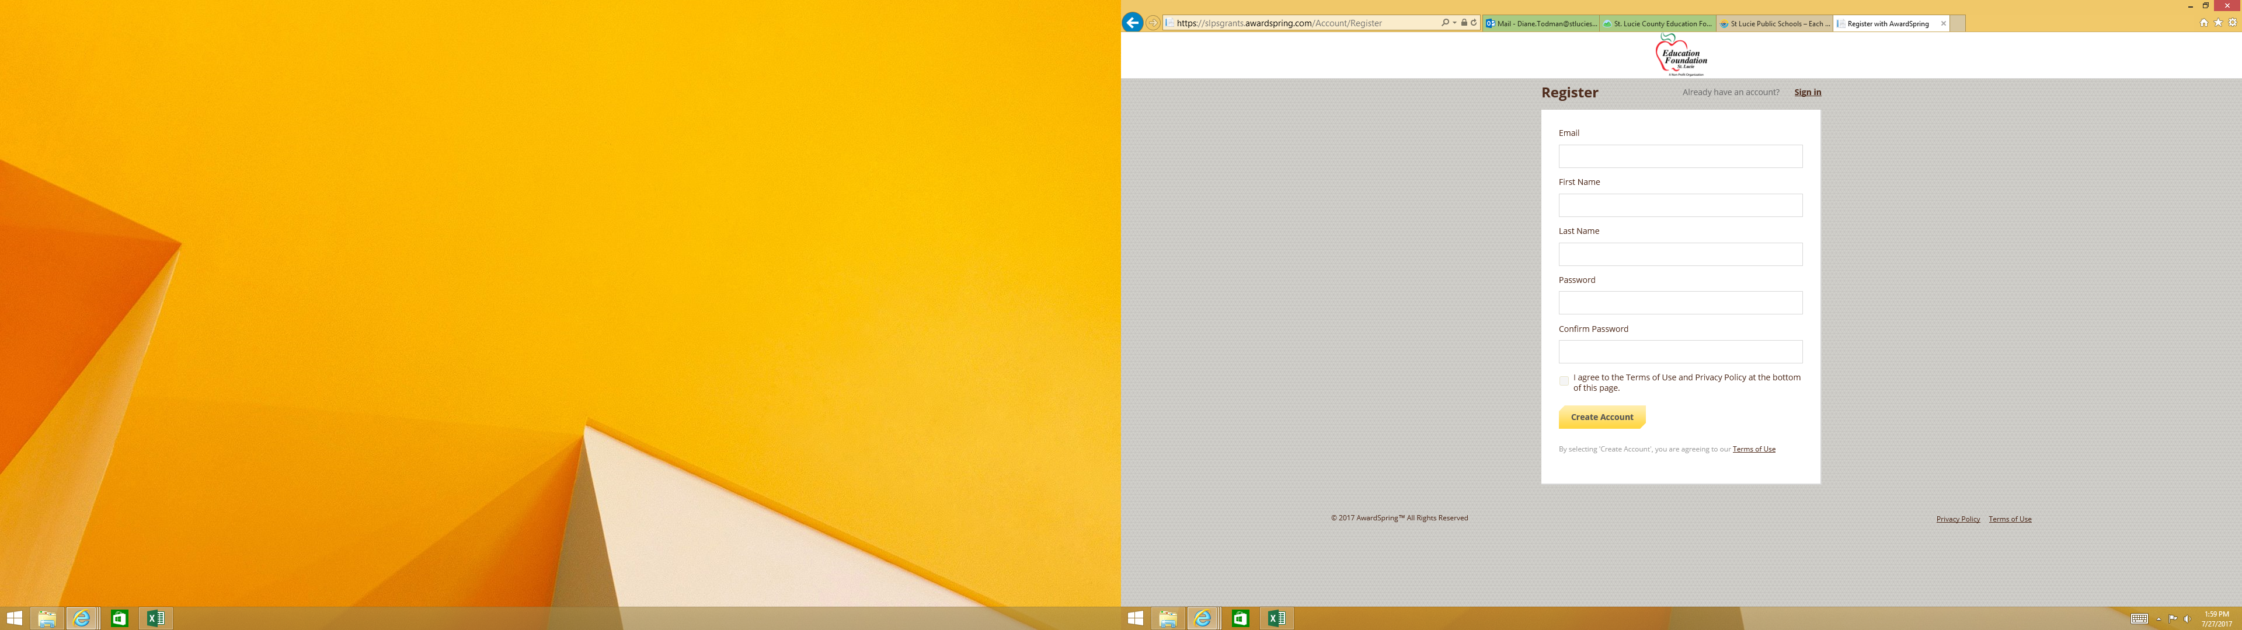
Teacher Grants 2022-2023
TO REGISTER
Input email address
Input First Name
Input Last Name
Input Password
Confirm Password
Agree to Terms
Click on Create Account

Slide 7
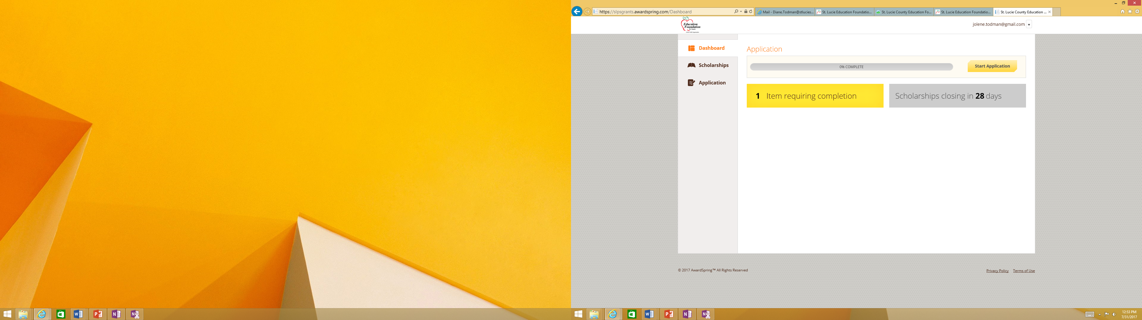
Teacher Grants 2022-2023
Screen View upon successful completion of registration and account setup

Slide 8
Teacher Grants 2022-2023
IMPORTANT NOTES
AwardSpring, our software vendor, modified the Scholarship software to be used for the Teacher Grant Online Application.
Therefore, some of the verbiage is programmatic from the Scholarship software and cannot be changed at present.
SCHOLARSHIPS =
TEACHER GRANTS

Slide 9
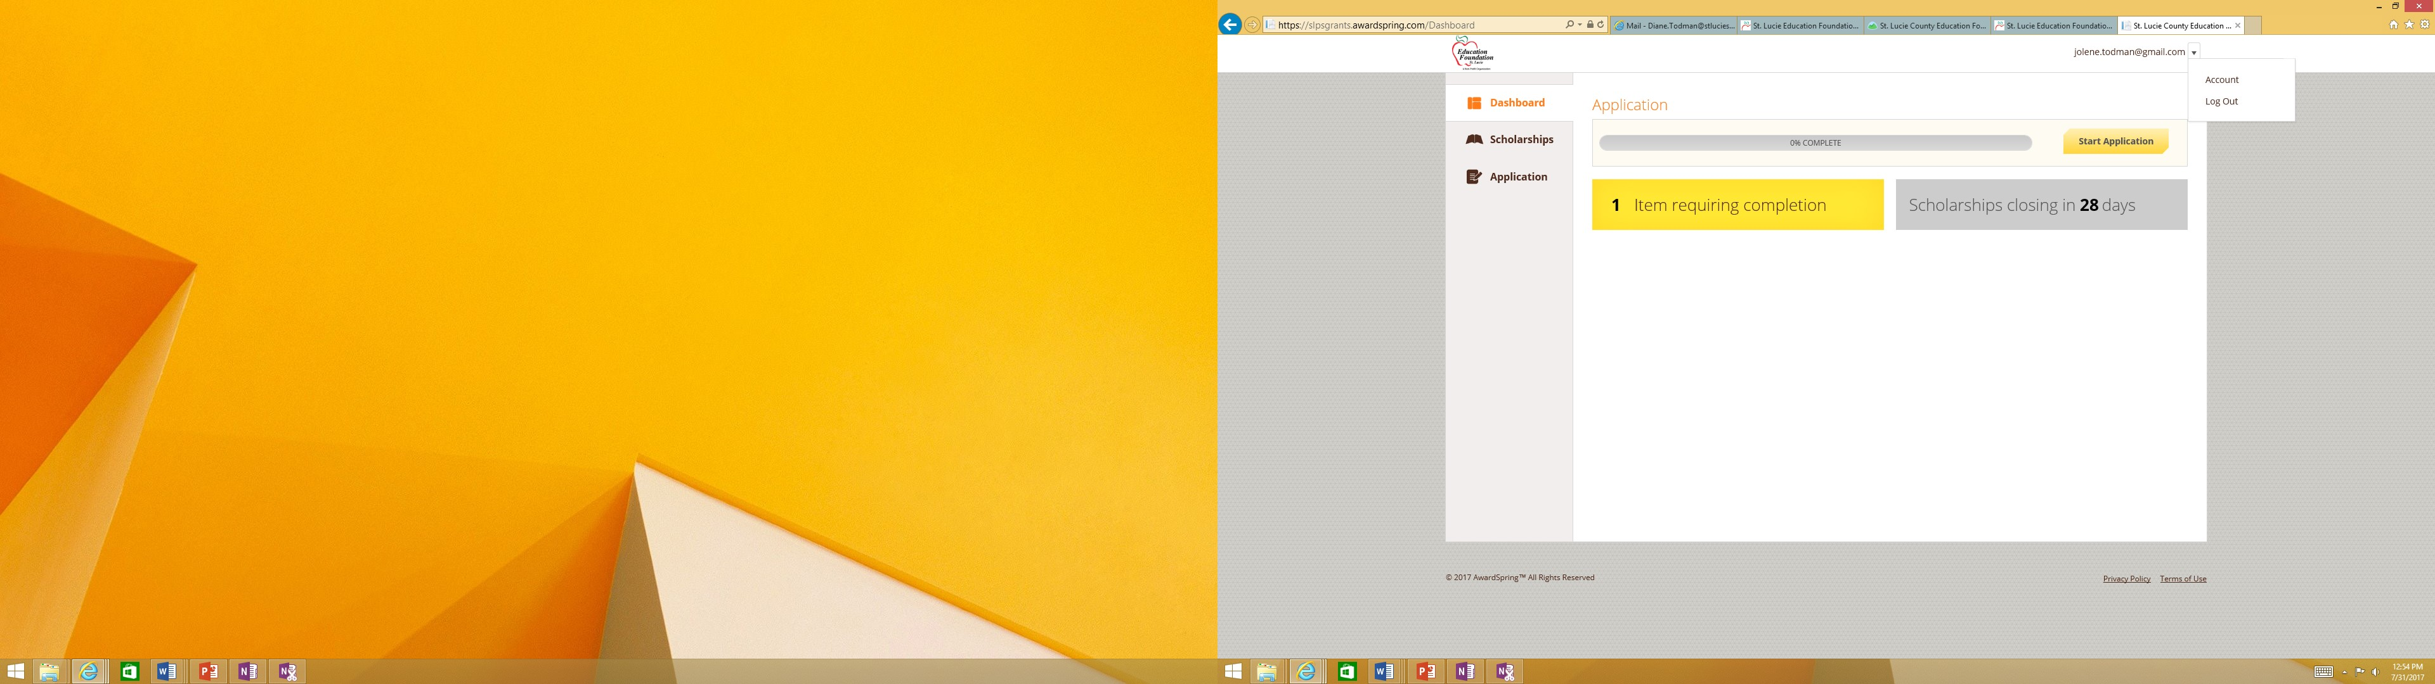
Teacher Grants 2022-2023
Upon completion of registration and account set up, you can then view your ACCOUNT or LOG OUT

Slide 10
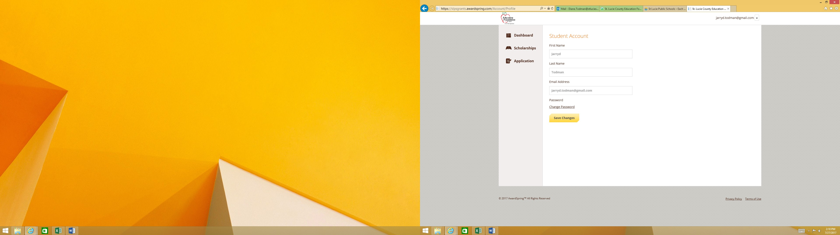
Teacher Grants 2022-2023
Student Account = Applicant’s Account
ACCOUNT VIEW
View your account and make changes as needed then Save Changes.
Notes:
The next screen will ask for information to facilitate registration: Email, Name, and Password. To complete registration and account setup agree to the Terms of Use and Privacy Policy then click on CREATE ACCOUNT.

Slide 11
Teacher Grants 2022-2023
NEXT STEP
View available Teacher Grants by clicking on the Book Icon labeled Scholarships
SCHOLARSHIPS =
TEACHER GRANTS

Slide 12
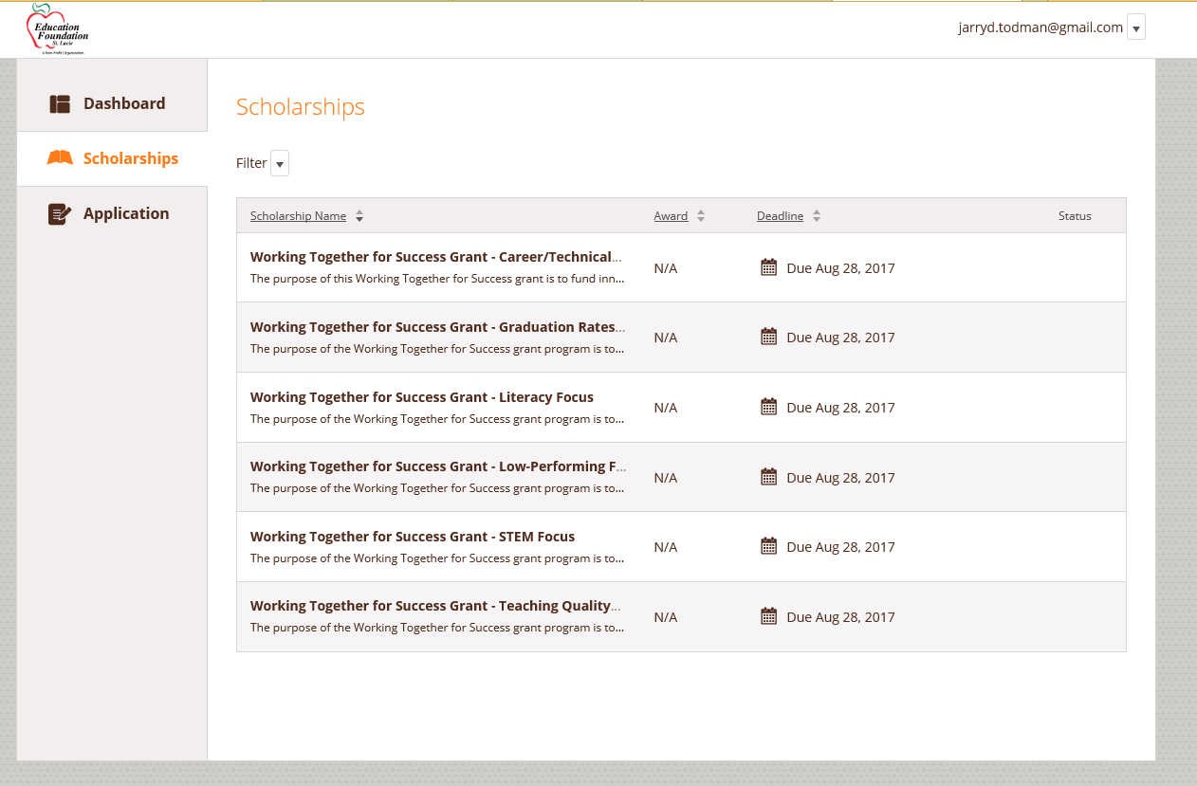
Teacher Grants 2022-2023
Listing of Teacher Grants along with Deadline date for application
Click on specific grant for an Overview, Qualifications and Quick Facts

Slide 13
Teacher Grants 2022-2023
CLICK ON EITHER OPTION TO START APPLICATION

Slide 14
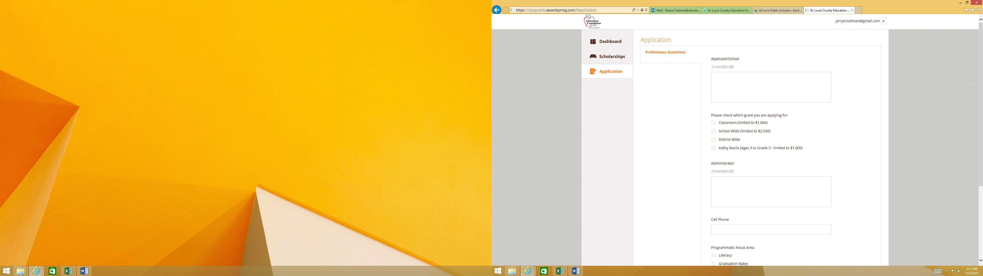
Teacher Grants 2022-2023
Online Application process starts with
the Preliminary Questions section which is relative to each area of focus which mimics the questions on the paper application with some slight changes

Slide 15
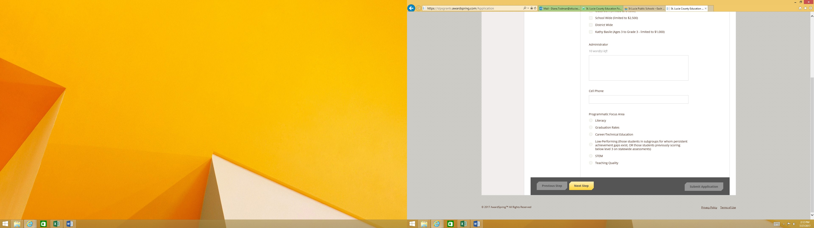
Teacher Grants 2022-2023
Online Application process starts with
the Preliminary Questions ends with the selection of the Programmatic Focus Area. Then click on NEXT STEP button

Slide 16
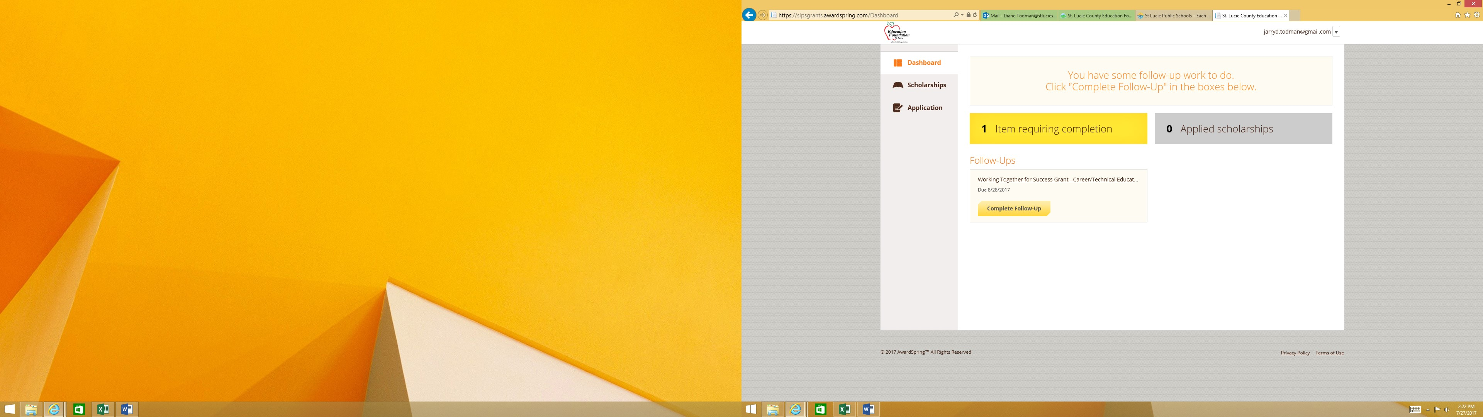
Teacher Grants 2022-2023
Applicant has selected the Career/Technical Education Grant
To complete the questions for the specific area of focus click on the button, Complete Follow-Up
This box is the applicants indicator of items pending completion to complete application

Slide 17
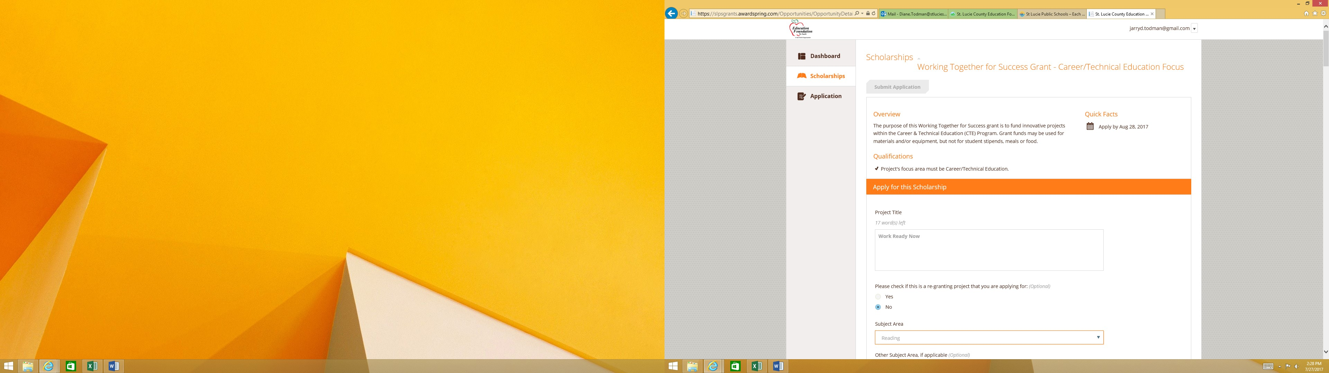
Teacher Grants 2022-2023
Apply for this Grant
Applicants can proceed with applying for grant by completing questions as prompted
Applicants can cut/copy and paste his/her responses from MS Word where applicable

Slide 18
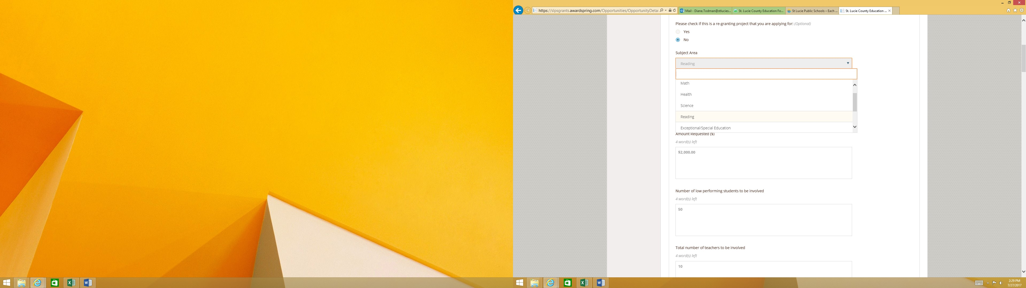
Teacher Grants 2022-2023
Apply for this Grant
Initial questions are standard to all areas of focus and mimic the questions on the paper application
REMINDER: Applicants can cut/copy and paste his/her responses from MS Word where applicable

Slide 19
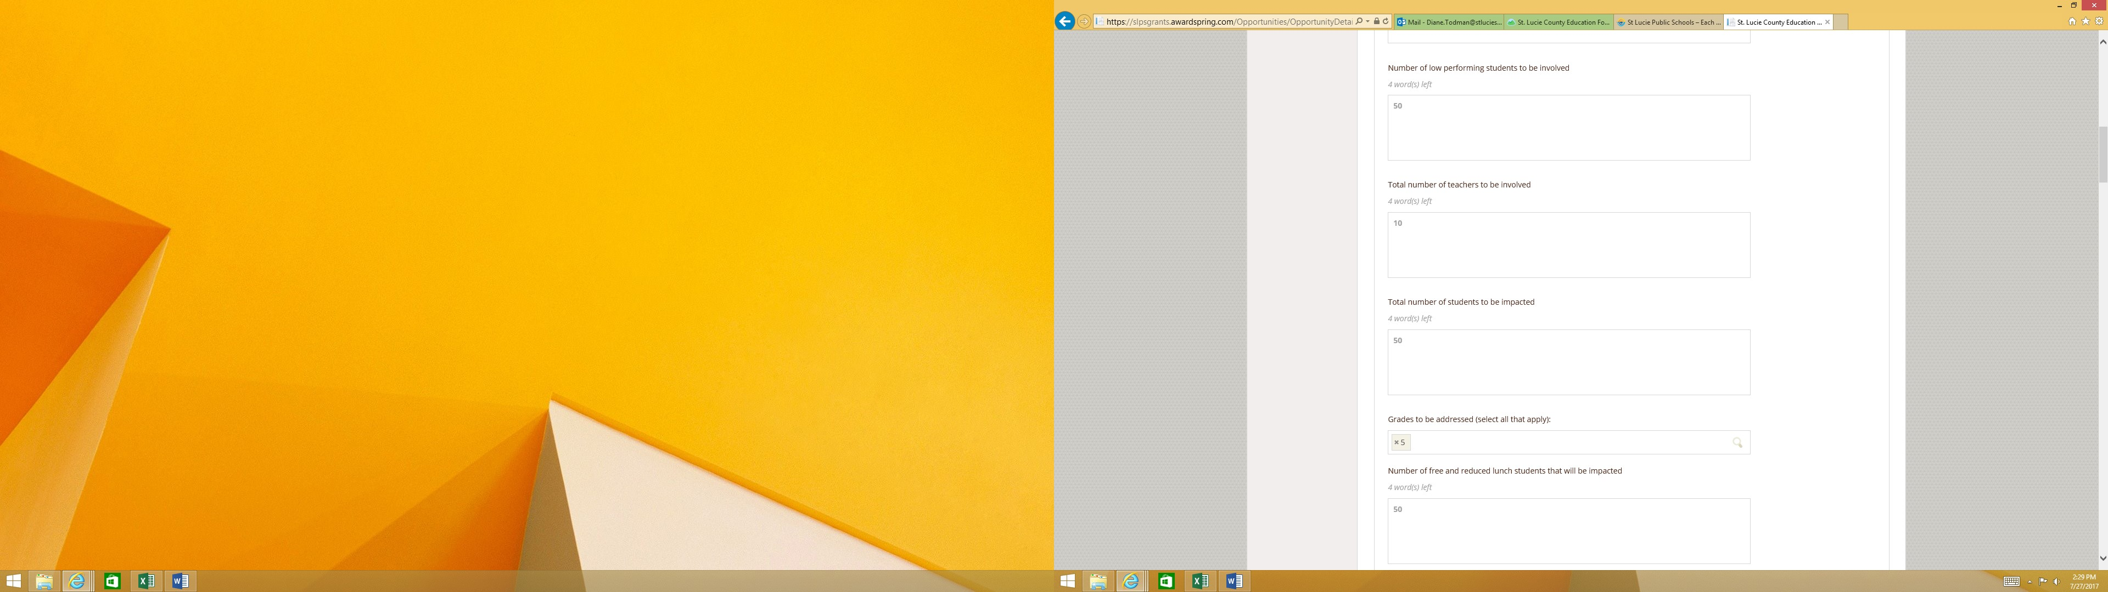
Teacher Grants 2022-2023
Apply for this Grant
Questions in this section are standard to all areas of focus and mimic the questions on the paper application with some slight changes
REMINDER: Applicants can cut/copy and paste his/her responses from MS Word where applicable

Slide 20
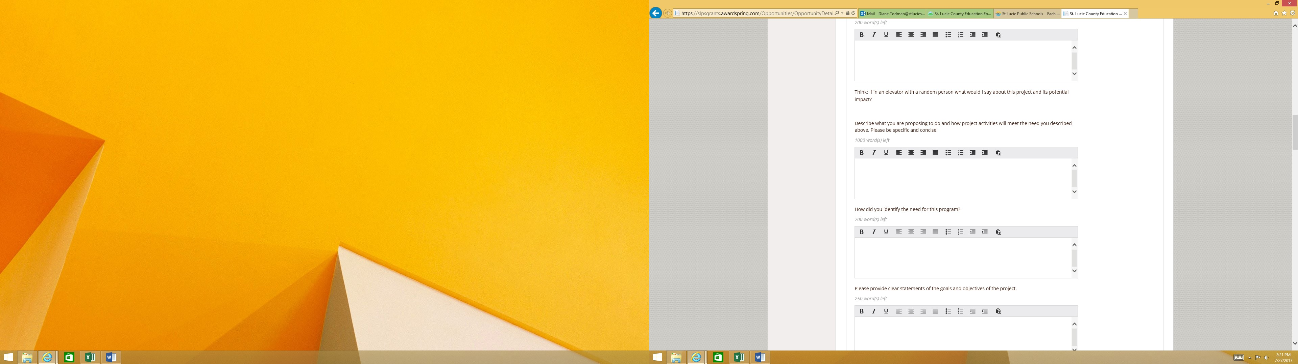
Teacher Grants 2022-2023
PROJECT DETAILS
Questions in this section are standard to all areas of focus and mimic the questions on the paper application
REMINDER: Applicants can cut/copy and paste his/her responses from MS Word where applicable

Slide 21
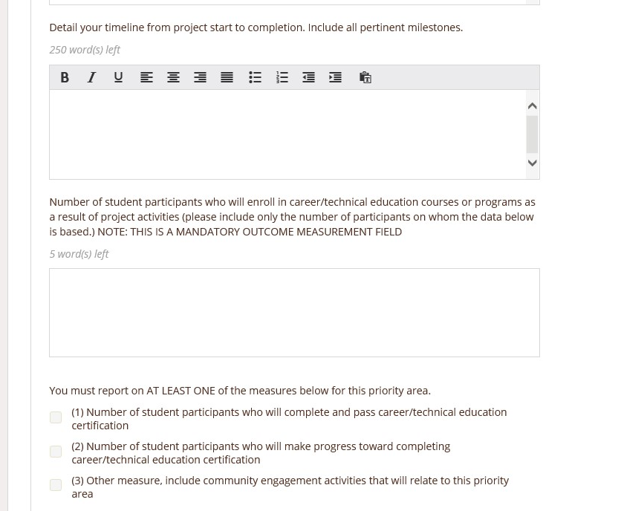
Teacher Grants 2022-2023
PROJECT DETAILS
Questions in this section are standard to all areas of focus and mimic the questions on the paper application
After completing the timeline detail, applicants will be prompted to complete question regarding the Outcome Measures specific to the area of focus.
REMINDER: Applicants can cut/copy and paste his/her responses from MS Word where applicable

Slide 22
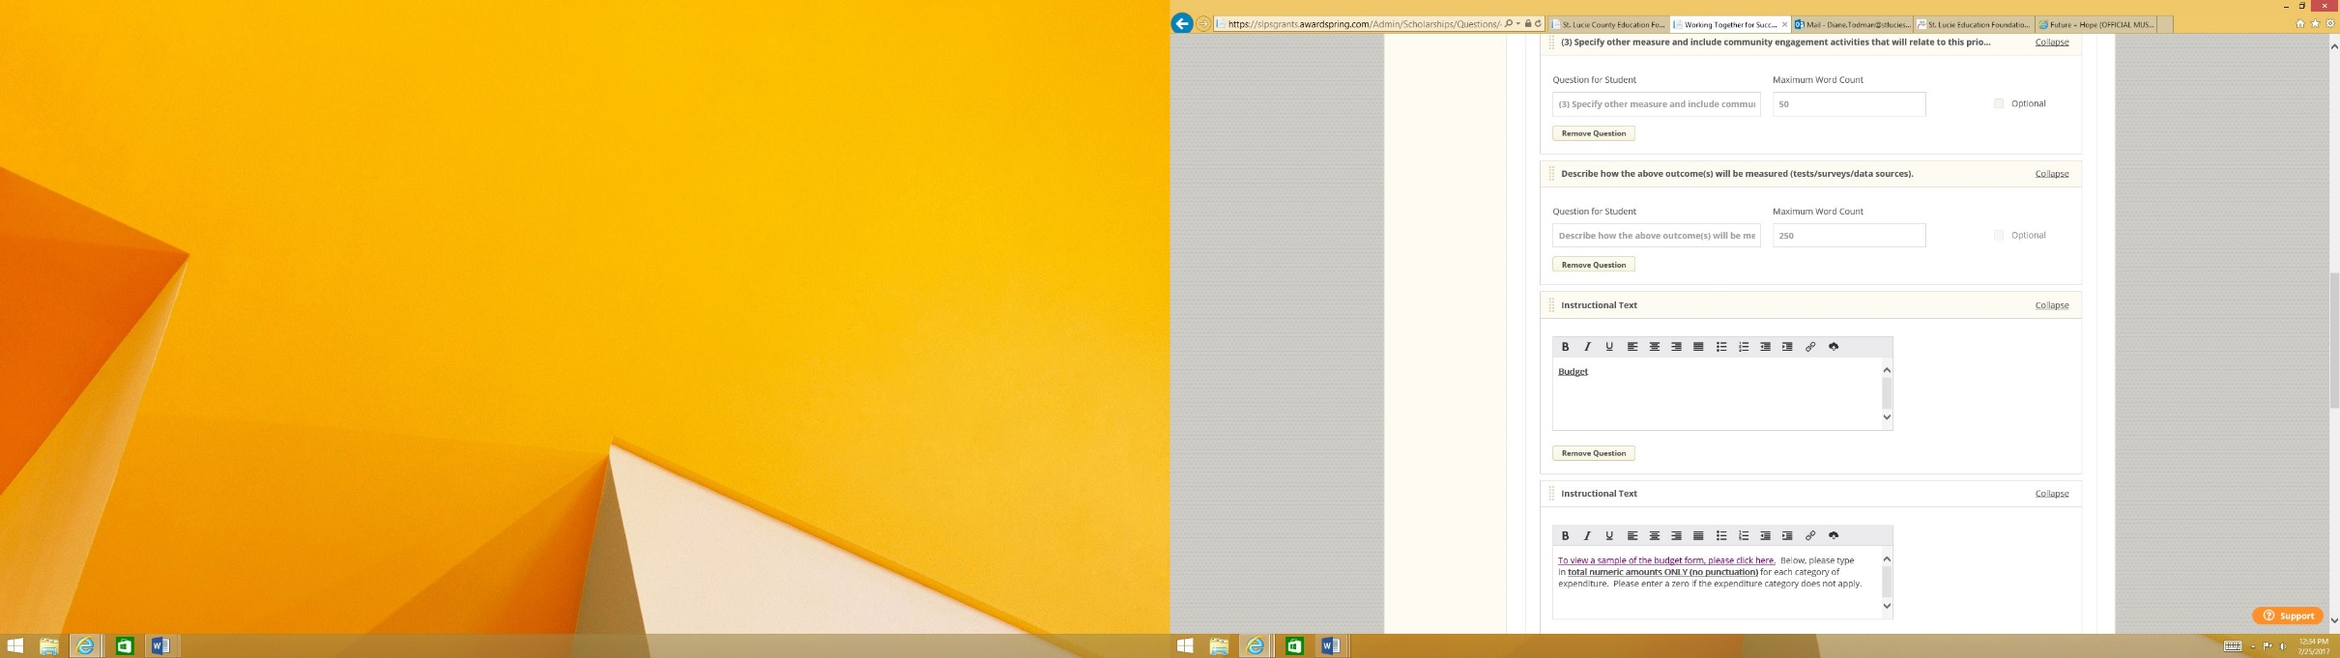
Teacher Grants 2022-2023
FINAL STEP
The last section of the Online Application is the Budget Detail Section which mimics the questions on the paper application.
If all sections have been satisfactorily completed, application can be submitted.

Slide 23

Teacher Grants 2022-2023
When you see the word Scholarships it actually refers to Teacher Grants.
When you see the word Student it actually refers to Applicant.
If you are unable to complete the application, the application is stored and you can resume completion (not after 9/30/2022).
If you have any questions or need assistance please email @Jackie. wolfe@stlucieschools.org.
Each applicant may only apply for one grant.

